Slide 1
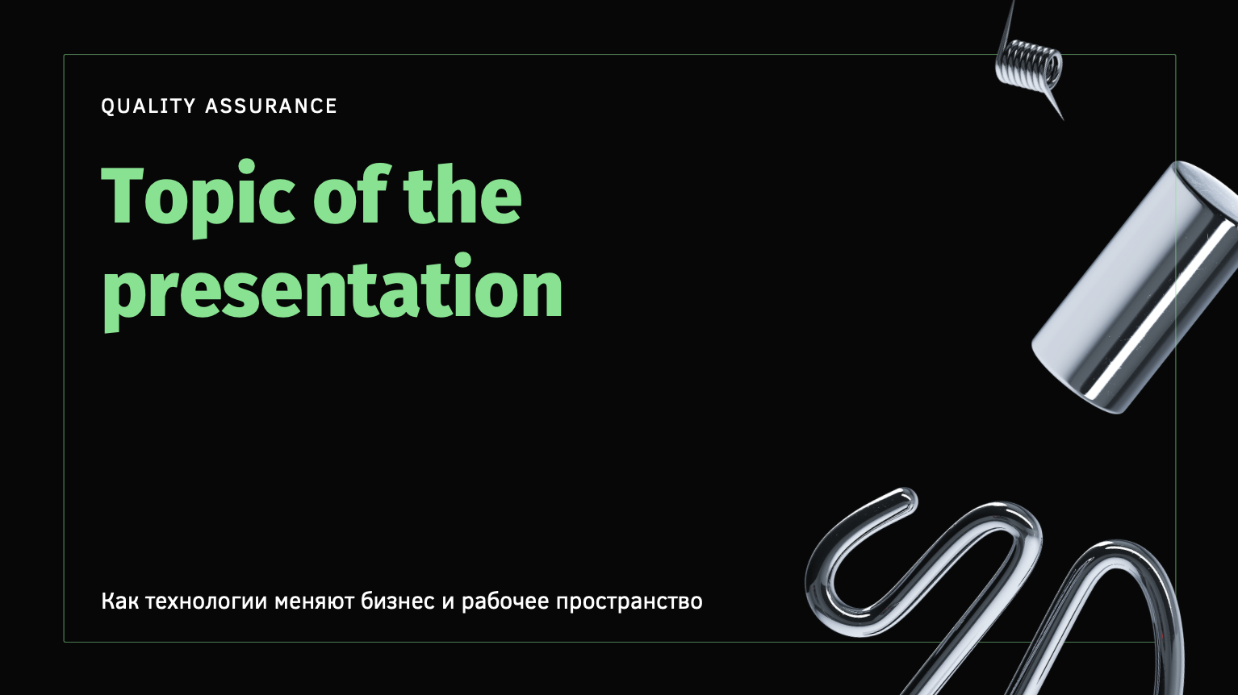
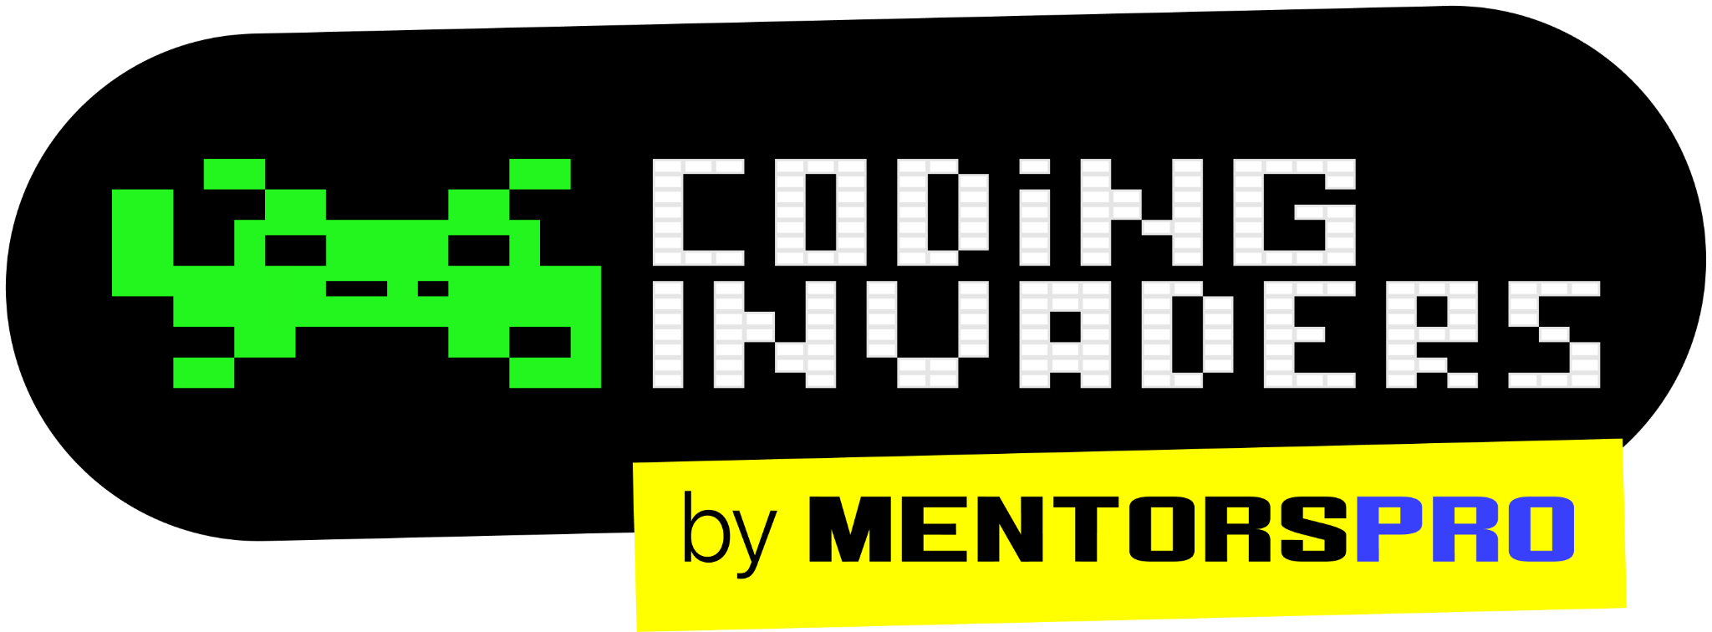
QA Automation Engineer
“Software Testing Types”
Session -5
Content Title
Notes:
Title - Fira Sans, 50pt
Subtitle - Fira Sans, 16pt

Slide 2
Types of Testing
Smoke Testing
Sanity Testing
Installation Testing
Black box testing
White Box Testing
System Testing
Usability Testing
Regression Testing
Defect Retesting
Random Testing
Performance Testing

Slide 3
Regression Testing
Performing the Testing on the related functionality of fixed defects or in modified application is called Regression Testing.
RT is the type of software testing that confirm the recent program or code changes have not destroyed the already existing functionality of a system.

Slide 4
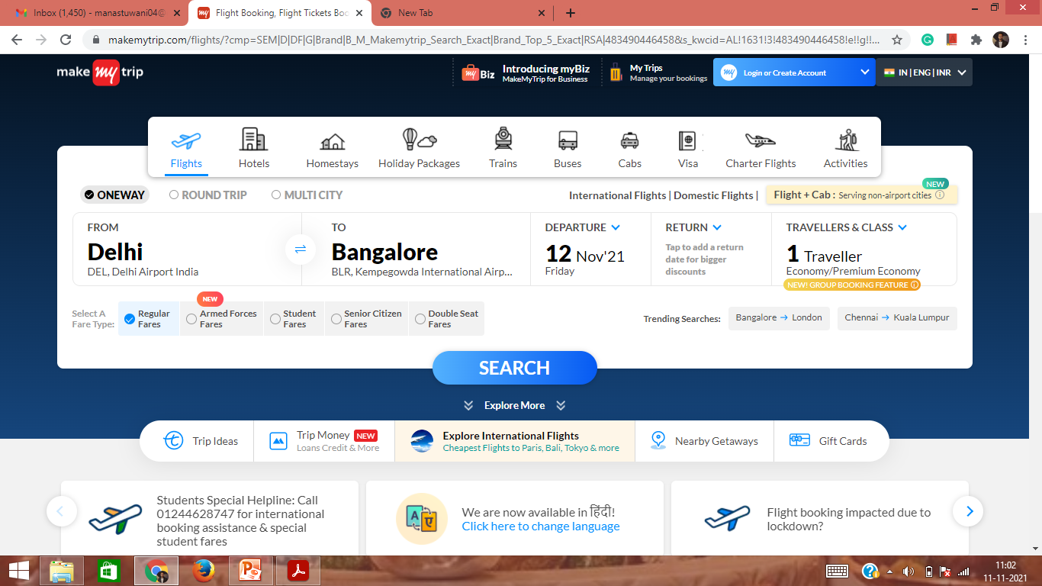

Slide 6
Regression Testing
Performing the Testing on the related functionality of fixed defects or modified application is called Regression Testing.

Slide 8

Regression Checklist
ONEWAY functionality
Round Trip functionality
UI Elements (such as Flight icon, Hotel icon etc.)

Slide 9
Regression Checklist
UI elements that are neighbors to the new feature
Adjacent functionality and Related Scenarios

Slide 10
Retesting
Performing the Testing on the fixed defects in an application is called Retesting or Defect Retesting

Slide 11
Regression testing

Slide 12
Regression Test case: It is a test case which comes under scope of Regression bucket.
Regression Defect: A Defect which has been Identified during performing Regression Testing is called Regression Defect
Regression Suit: Collection of multiple Regression test case is called Regression Suit.
Retesting

Slide 13
Difference Between Regression Testing and Retesting
Regression Testing | Retesting
Testing of related Functionality of the Fixed defect or modified application. | Testing of functionality of the Fixed defect.
Involves testing a general area of the software. | Involves testing a specific feature of the software.
Testing software which was working, but now, due to updates, might not be working | Testing software which was not working, but have been fixed and you test it to confirm that it is now fixed or not.
Should always be a part of the testing process and performed each time code is changed and a software update is about to be released. | Is only a part of the testing process if a defect or bug is found in the code.

Slide 14
Random Testing or Monkey Testing
Performing testing on the application randomly (without any sequence) is called Random Testing.
We are performing Random testing only when we don’t have sufficient time to complete the testing in a project.

Slide 15
Diff between Functional Testing and Non-Functional Testing
Functional Testing | Non-Functional Testing
It is performed to comprehend the behavior of the system according to the client functional needs and requirements | It is the process that helps comprehend whether the performance of the system is according to the client’s requirements
Manual and automation testing tools are used to perform it | Effective tools are used to perform it after functional testing
It is quite easy to perform | It is difficult to perform
Functional testing covers: Regression Testing Smoke Testing User Acceptance Testing Sanity Testing Integration testing | Non-functional testing covers: Performance Testing Compatibility Testing Load, Stress, Volume Testing Security Testing

Slide 16
Performance Testing Performance is nothing but the response time of the application as per the action we made it. Performance Testing is a software testing process used for testing the speed, response time, stability, reliability, and resource usage of a software application under workload. It is the process of determining the speed, effectiveness, reliability, scalability, and other important features and elements of the system. Moreover, it is also used to compare two or more applications as well as to evaluate their system speed, data transfer rate, bandwidth, and more. .

